Slide 1
Impact of Flexible Working Arrangements On Parents
Dr. Sara Ali Abdulla
Neurological Disorders Research Center
Qatar Biomedical Research Institute
Hamad Bin Khalifa University
Qatar Foundation
saabdulla@hbku.edu.qa

Slide 2
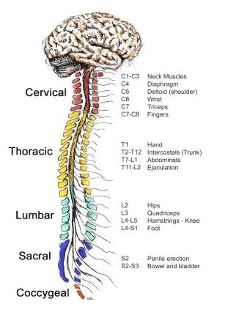
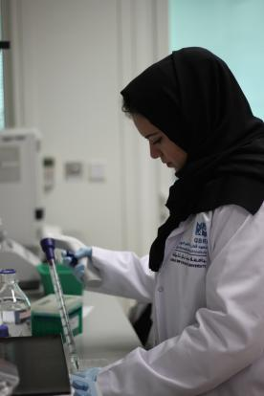
BSc Honors and PhD in Clinical Neurosciences

Slide 3
Elucidate the underlying mechanisms of neurological disorders
to facilitate diagnosis and therapeutic interventions
Proteomics
Metabolomics
Predictive Biomarkers
Personalized Medicine
Genomics
Functional
Studies
AIM: To identify molecular biomarkers for the early diagnosis of ASD
as well as enhance an understanding of the underlying mechanisms of its pathophysiology.

Slide 4
BSc Honors and PhD in Clinical Neurosciences

Slide 5
Hurdles of “official” working hours on parents
Struggling to attend to both work and school requirements
Background
Fear of announcing pregnancy
Women encouraged to give up on career goals
Working Haphazardly or slowly
Burn Out
Goal
Current working structure
More Autonomy and Flexibility
Guilt
Continuous Stress
Unhappy,
Working for the sake of money
Extreme pressure on mothers
Pressure to compete with employees that stay until or past 5 pm

Slide 6
Benefits of flexible working arrangements on one’s personal growth and output
Work Smarter,
Increased Productivity
Efficient and concise meetings, regular, time-saving
Personal Development

Slide 7
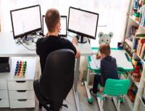
Impact of flexible working arrangements for parents and children
Empower both parents to rise in their career
Happier parents provide a happier home
School pick up and
drop offs
Reduced commuting times and costs
Improved mental well-being
More time for stress free learning
Reduced
childcare costs
Bonding time
Fostering essential skills from a young age
Develop strong
work ethic
Foster time management
Mirror behaviors
that they would normally not be exposed to
Value
quality time
Inquisitive

Slide 8
Flexible hours does not mean less working hours or less productivity
Working
out of the office
Working
in the office
Dynamic and depends on responsibilities
Work during effective energy cycles
The unforeseen events of the pandemic should not be used as a sole reference to conclude on the impacts of working out of the office (i.e. closing of schools/nurseries/activities, having to work official hours at home).

Slide 9
To date: The most impactful events as a result of flexible working arrangements in my work and personal life
Work
Personal
Boost in productivity - My team has significantly increased our work efficiency and output in 2020 to date
Less hassle on homework and school activities. Avoids stressful nights and tears from being too tired to study.
Nurtured a less stressful working environment, more focus on research questions and investigations
My child’s learning improved dramatically, surpassing what is required for his grade level
Managed to publish more research articles, and obtain a patent on a diagnostic method for ASD
More bonding time, less tears when I need to work
Developed a stronger working family, more support for each other
Development of a strong work ethic, and consideration of work/family balance, from a young age
Improved morale, safe space to be discuss work place agreements – clear and improved communication
More supportive environment for each parent to accomplish their work tasks

Slide 10
Flexible working arrangements have significant benefits,
and should be integrated as a norm

Slide 11
Thank you
Dr. Sara Ali Abdulla
Neurological Disorders Research Center
Qatar Biomedical Research Institute
Hamad Bin Khalifa University
Qatar Foundation
saabdulla@hbku.edu.qa

